Slide 1

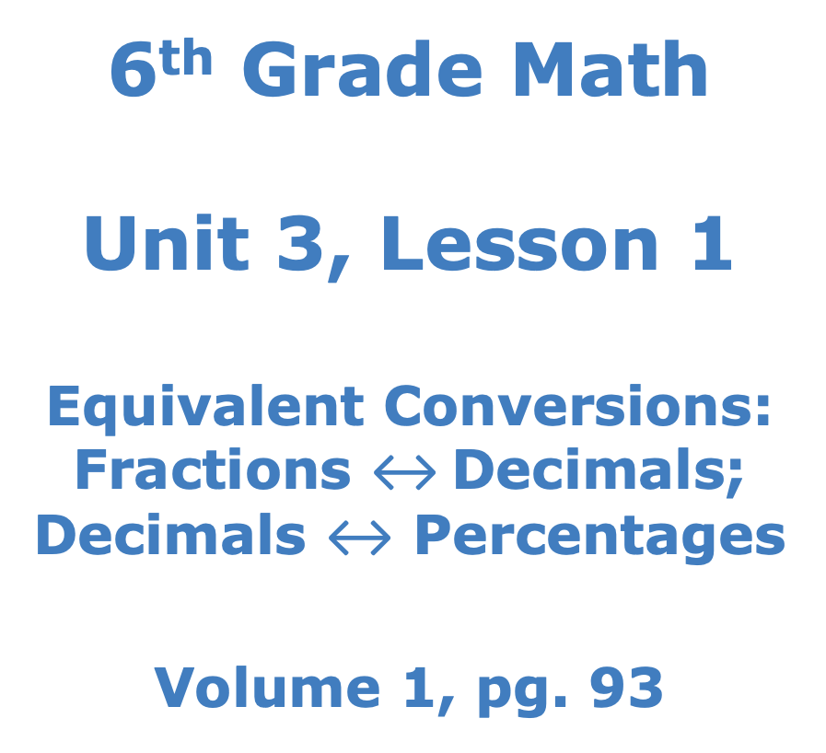
6th Grade Math Unit 3, Lesson 1 Equivalent Conversions: Fractions $↔$Decimals; Decimals $↔$ Percentages Volume 1, pg. 93

Slide 2


Benchmark
MA.6.NSO.3.5
Rewrite positive rational numbers in different but equivalent forms including fractions, terminating decimals, and percentages.
volume 1, pg. 93

Slide 3
Integrated Mathematical Thinking and Reasoning Standard
MA.K12.MTR.3.1 Complete tasks with mathematical fluency.
volume 1, pg. 93

Slide 4

Learning Targets
I can convert between fractions and decimals.
I can convert between percentages and decimals.
volume 1, pg. 93

Slide 5

Warm-Up
volume 1, pg. 93

Slide 6
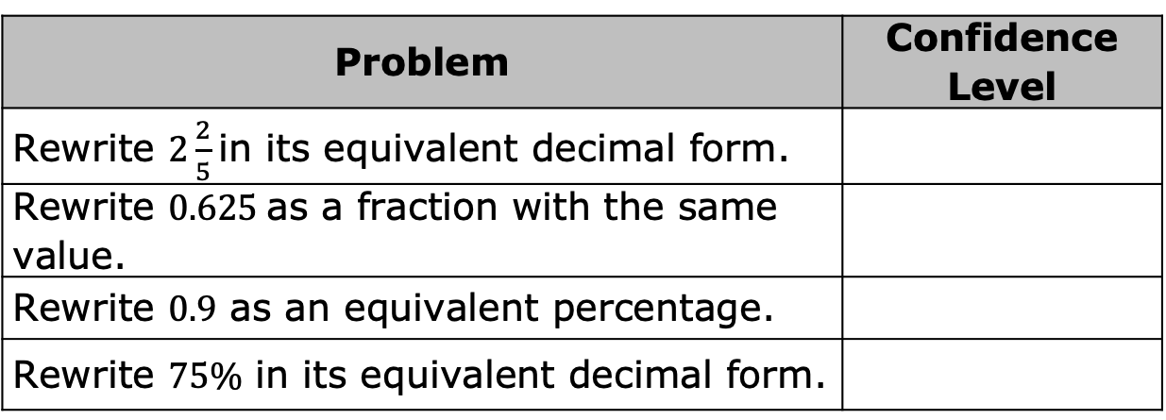
3.1.1 Warm-Up:
Self-Evaluation
For each problem, rate your level of confidence in your ability to answer each question, but don’t actually answer them.
Use a scale from 1 to 5, where 1 means you do not feel confident about how to answer the question, and 5 means you feel very confident.
Problem | Confidence Level
Rewrite $2\frac{2}{5}$ in its equivalent decimal form.
Rewrite $0.625$ as a fraction with the same value.
Rewrite $0.9$ as an equivalent percentage.
Rewrite $75\%$ in its equivalent decimal form.
volume 1, pg. 93

Slide 7

Guided Instruction
volume 1, pg. 94

Slide 8
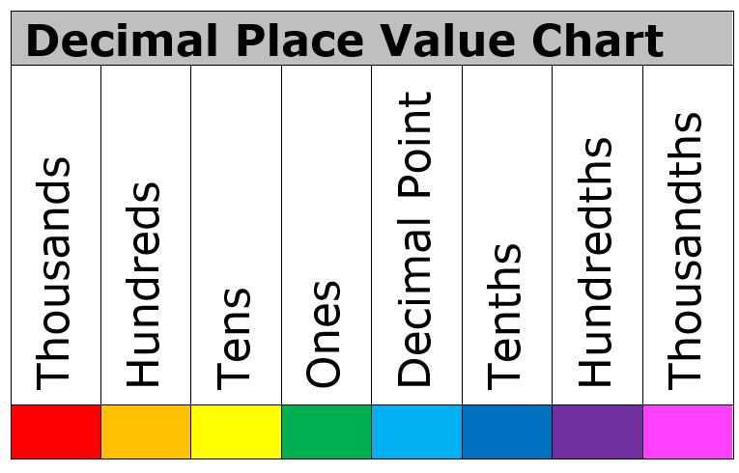

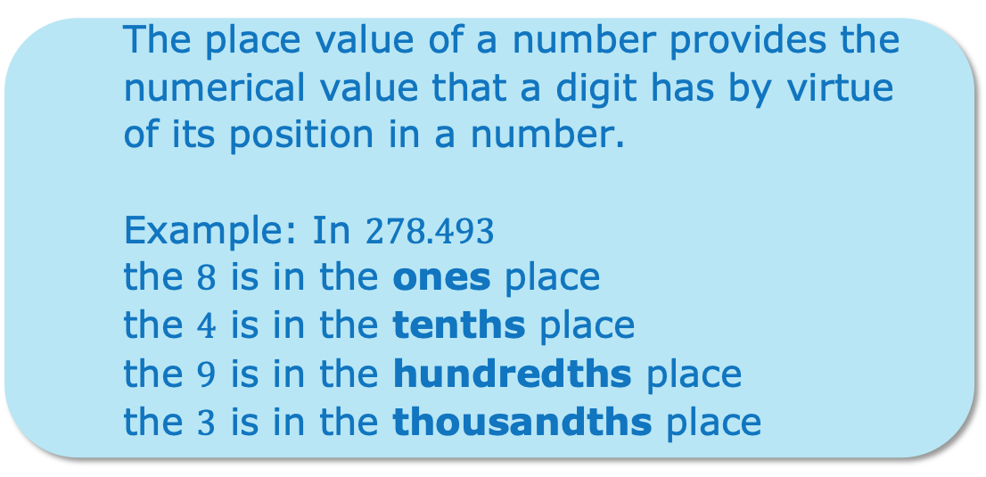
3.1.2 Guided Instruction: Fraction and Decimal Conversions
The place value of a number provides the numerical value that a digit has by virtue of its position in a number.
Example: In $278.493$
the $8$ is in the ones place
the $4$ is in the tenths place
the $9$ is in the hundredths place
the $3$ is in the thousandths place
volume 1, pg. 94

Slide 9
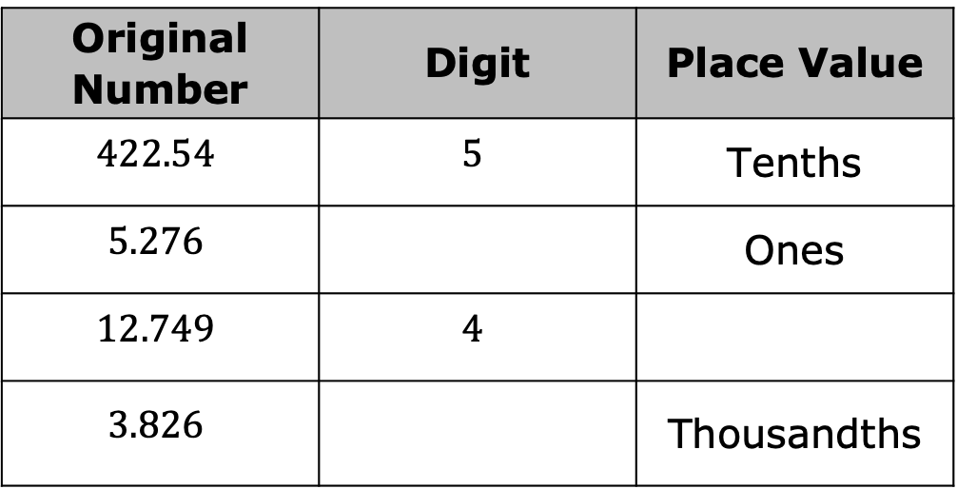

Use the original number to fill in the missing digits and place values.
Consider the number $0.08$.
In the number $0.08$, what is the place value of the final digit?
Original Number | Digit | Place Value
$$422.54$$ | $$5$$ | Tenths
$$5.276$$ |  | Ones
$$12.749$$ | $$4$$
$$3.826$$ |  | Thousandths
volume 1, pg. 94

Slide 10
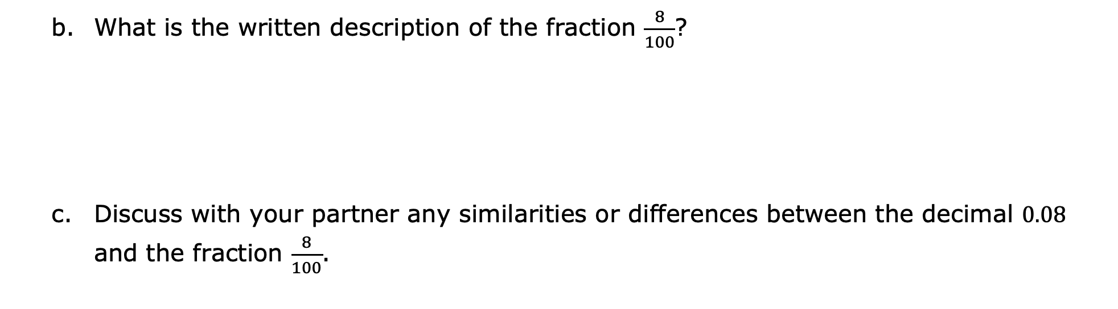
What is the written description of the fraction $\frac{8}{100}$?
Discuss with your partner any similarities or differences between the decimal $0.08$ and the fraction $\frac{8}{100}$.
When rewriting a decimal that is greater than 0 but less than 1 as an equivalent fraction, use the place value of the final digit to determine the denominator of the fraction.
volume 1, pg. 94

Slide 11



In the decimal $0.7$, the final digit is in the
place, so is the equivalent
fraction form.
In the decimal $0.037$, the final digit is in the
place, so is the equivalent
fraction form.
$\frac{7}{10}$
$\frac{7}{100}$
$\frac{7}{1000}$
tenths
hundredths
thousandths
tenths
hundredths
thousandths
$\frac{37}{10}$
$\frac{37}{100}$
$\frac{37}{1000}$
volume 1, pg. 95

Slide 12
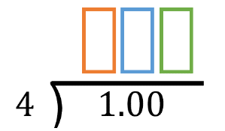
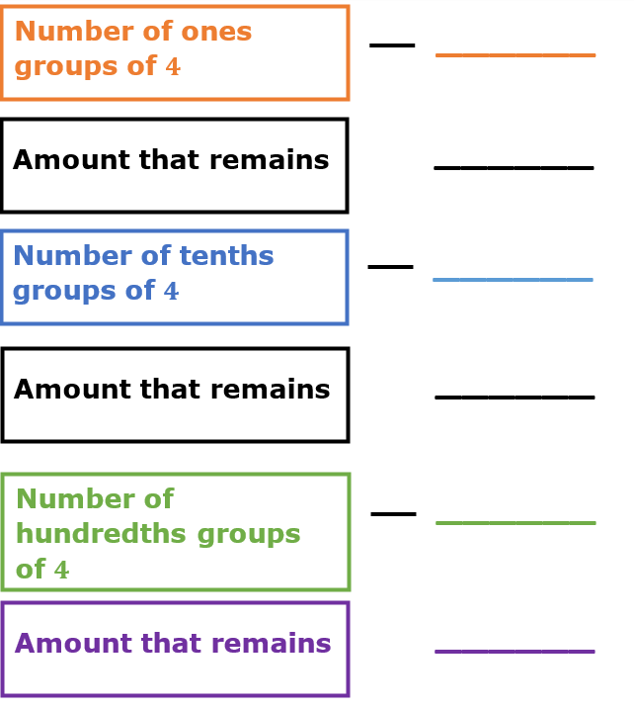
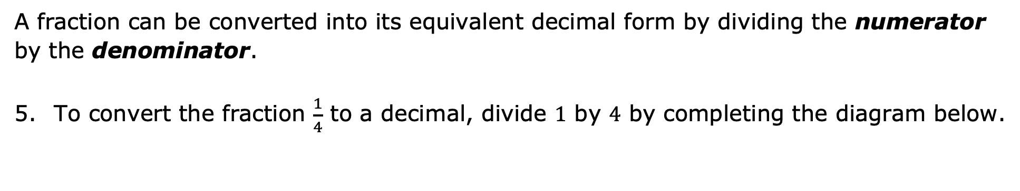
A fraction can be converted into its equivalent decimal form by dividing the numerator by the denominator.
To convert the fraction $\frac{1}{4}$ to a decimal, divide $1$ by $4$ by completing the diagram below.
volume 1, pg. 95

Slide 13

Guided Practice
volume 1, pg. 96

Slide 14

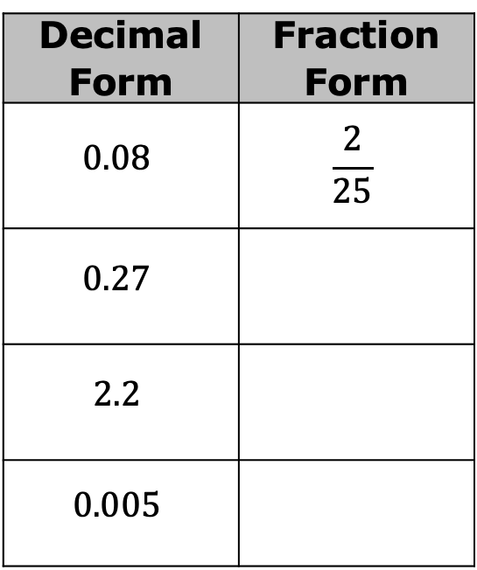
3.1.3 Guided Practice: Fraction and Decimal Conversions
Complete the table by converting each decimal to an equivalent fraction. If possible, write the equivalent fraction so that the numerator and denominator have no common factors.
Decimal Form | Fraction Form
$$0.08$$ | $$\frac{2}{25}$$
$$0.27$$
$$2.2$$
$$0.005$$
volume 1, pg. 96

Slide 15
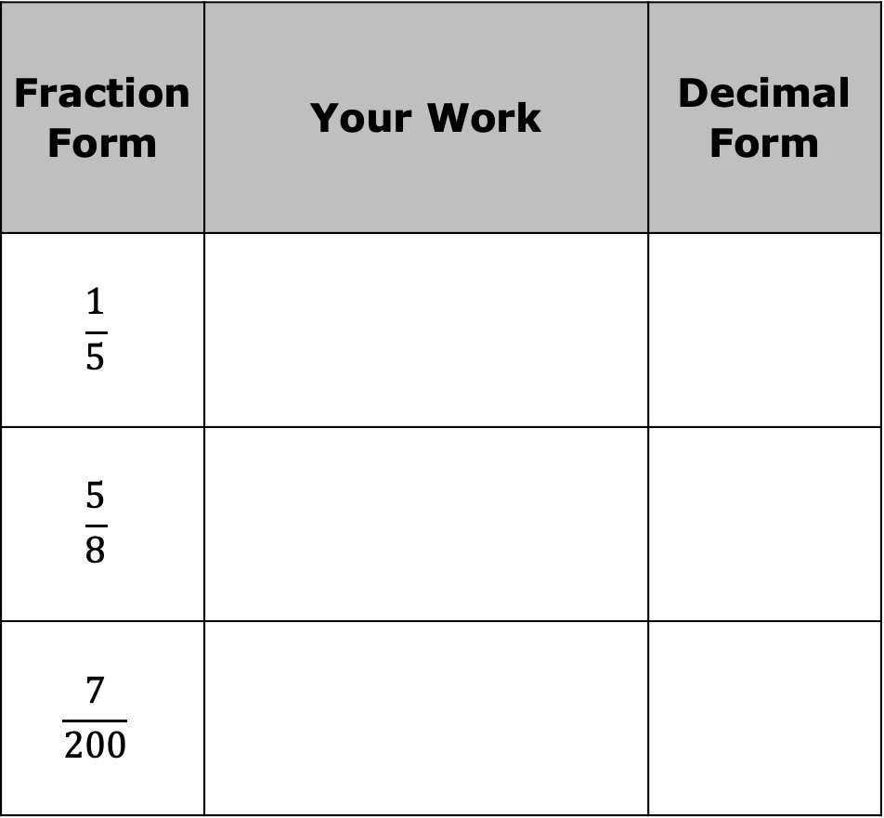
Complete the table by rewriting each fraction as its equivalent decimal.
Fraction Form | Your Work | Decimal Form
$$\frac{1}{5}$$
$$\frac{5}{8}$$
$$\frac{7}{200}$$
volume 1, pg. 96

Slide 16
Guided Instruction
volume 1, pg. 97

Slide 17
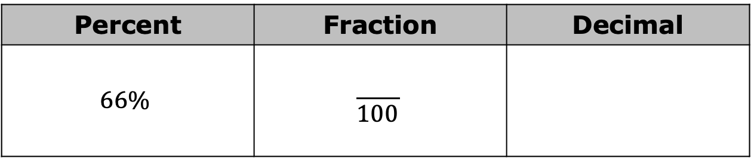
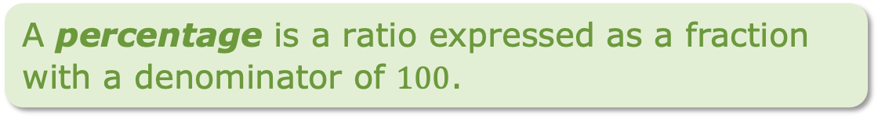
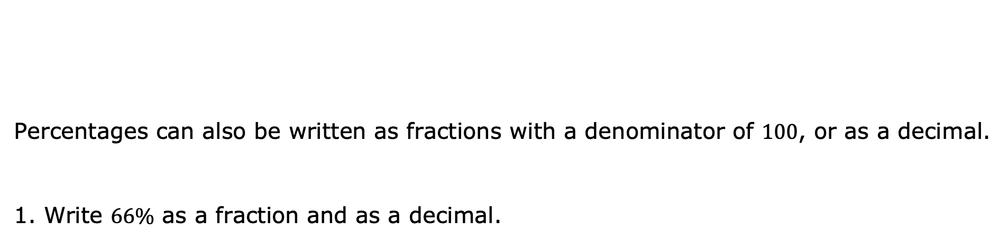
3.1.4 Guided Instruction: Decimal and Percentage Conversions
Percentages can also be written as fractions with a denominator of $100$, or as a decimal.
Write $66\%$ as a fraction and as a decimal.
A percentage is a ratio expressed as a fraction with a denominator of $100$.
Percent | Fraction | Decimal
$$66\%$$ | $$\frac{ }{100}$$
volume 1, pg. 97

Slide 18
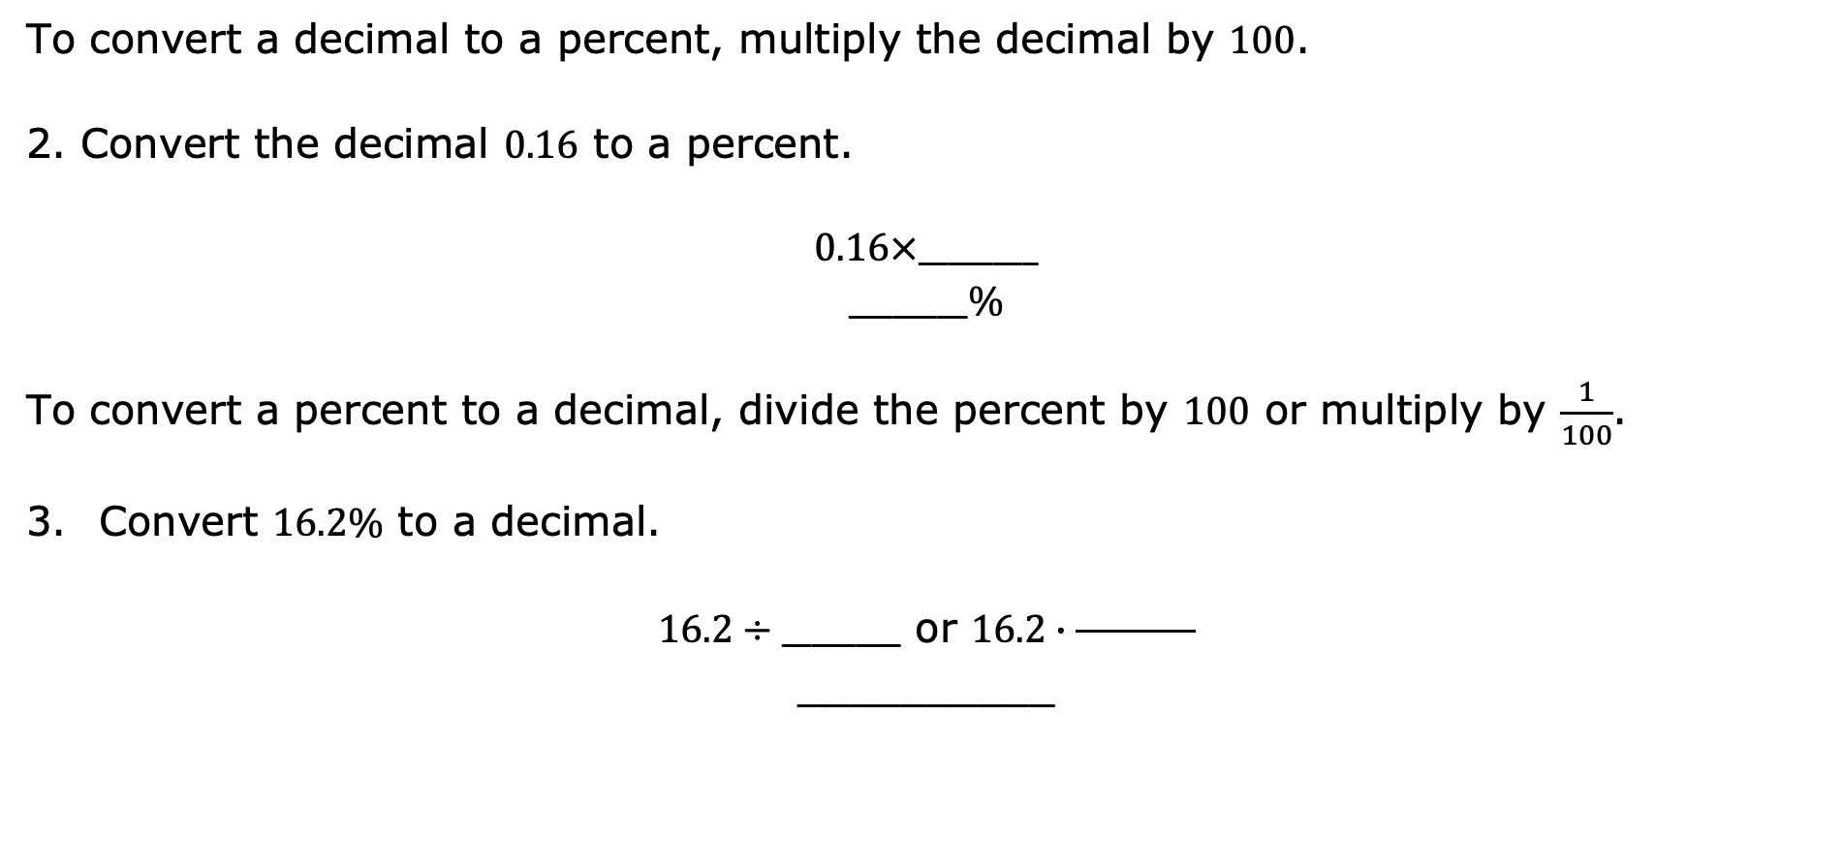
To convert a decimal to a percent, multiply the decimal by $100$.
Convert the decimal $0.16$ to a percent.
$$0.16×________$$
$$________\%$$
To convert a percent to a decimal, divide the percent by $100$ or multiply by $\frac{1}{100}$.
Convert $16.2\%$ to a decimal.
$16.2÷________$ or $16.2∙\frac{ }{ }$
__________
volume 1, pg. 97

Slide 19
Guided Practice
volume 1, pg. 97

Slide 20
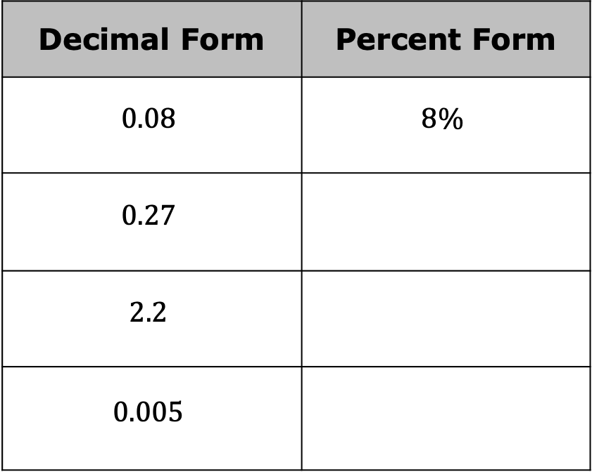
3.1.5 Guided Practice: Decimal and Percentage Conversions
Complete the table by converting each decimal to an equivalent percentage.
Decimal Form | Percent Form
$$0.08$$ | $$8\%$$
$$0.27$$
$$2.2$$
$$0.005$$
volume 1, pg. 97

Slide 21
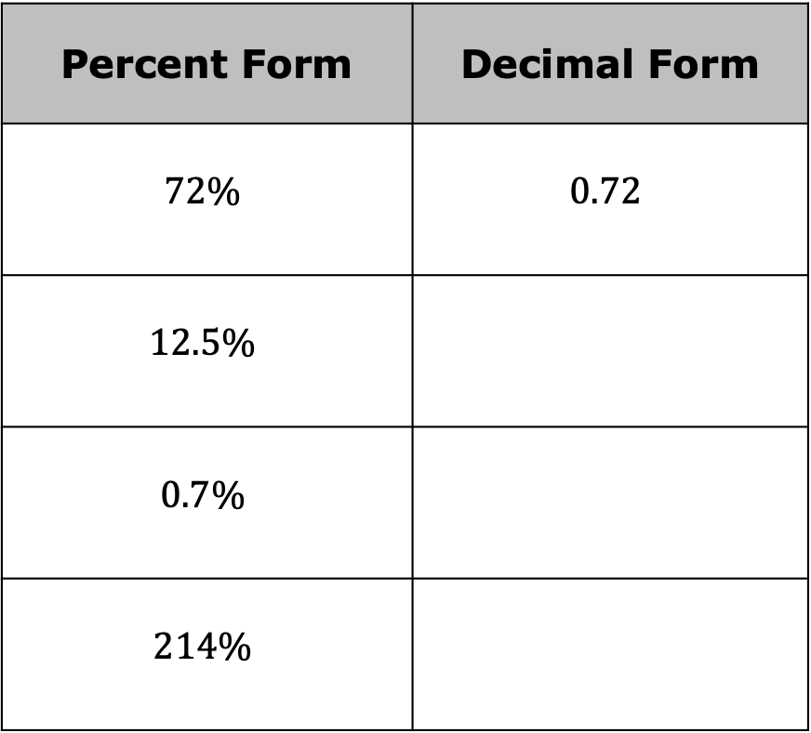
Rewrite each percentage into its equivalent decimal form to complete the table.
Percent Form | Decimal Form
$$72\%$$ | $$0.72$$
$$12.5\%$$
$$0.7\%$$
$$214\%$$
volume 1, pg. 97

Slide 22

Your Turn
volume 1, pg. 98

Slide 23

3.1.6 Your Turn!
Rewrite each percentage as a decimal.
a. $125.6\%$ b. $3\%$
Convert each decimal to an equivalent percentage.
a. $0.008$ b. $4.71$
volume 1, pg. 98

Slide 24

Rewrite each fraction as a decimal.
a. $\frac{1}{2}$ b. $2\frac{1}{10}$
Rewrite each decimal as an equivalent fraction. Simplify where applicable.
$\text{a}\text{.} 0.94$ b. $1.7$
volume 1, pg. 98

Slide 25

Wrap-Up
volume 1, pg. 98

Slide 26
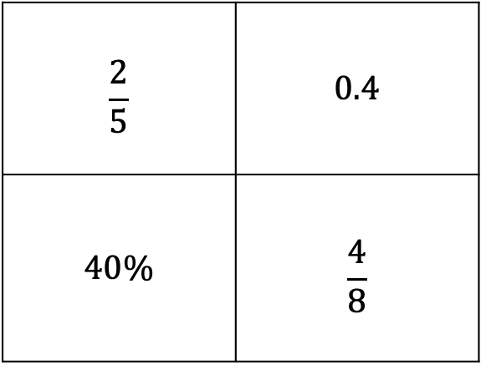
3.1.7 Wrap-Up: Ticket Out the Door
Circle the expression that does not belong.
Explain your reasoning for your choice.
$$\frac{2}{5}$$ | $$0.4$$
$$40\%$$ | $$\frac{4}{8}$$
volume 1, pg. 98

